Slide 1
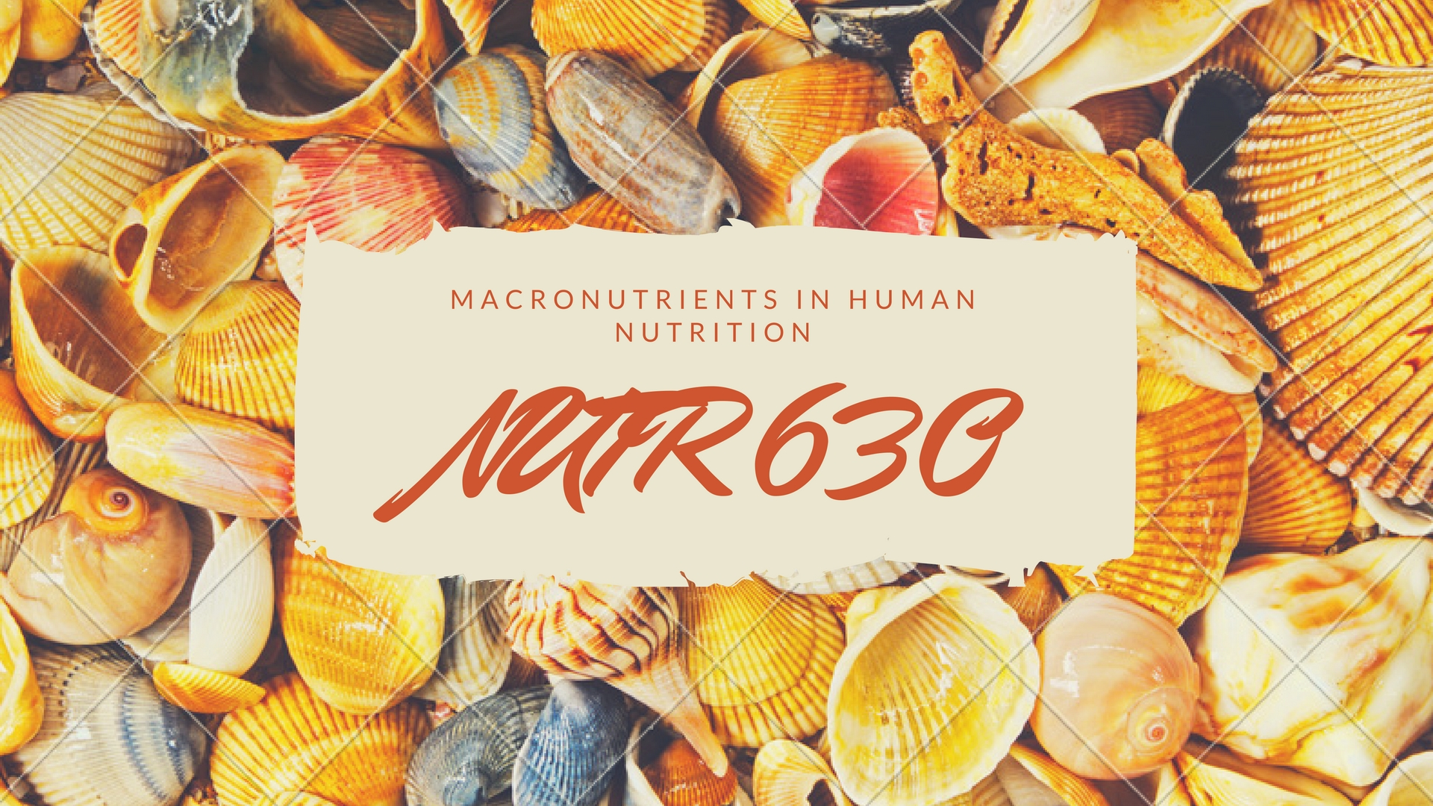

Slide 2
Objectives
Learn about the instructors
Overview of Gameful Learning Theory and GradeCraft platform
Review elements of course
Take concept inventory
Touch on the overall themes of the course

Slide 3
Who are we?
Dr. Liv Anderson, Clinical Assistant Professor
Will teach most of the digestion lectures
Dr. Dave Bridges, Assistant Professor
Will teach most of the metabolism lectures
Noura El Habbal, GSI
Will run review sessions
Will teach the lipid oxidation lecture
Notes:
Should be at minute 10 here.

Slide 4
Who are you?
Results of student onboarding survey

Slide 5
Food Rankings
Rank the foods on this handout from best to worst
Discuss your food rankings in groups of 5-6
Introduce yourself to the others in the group
Decide on group rankings (take about 10 mins)
Feedback
What are some criteria that your group used to define “good”
What food was the most controversial?
Notes:
Start this at 1:45

Slide 6
What food is healthy?
Percent of nutritionists
saying a food is healthy
Taken from the New York Times Upshot article from July 5, 2016.
https://www.nytimes.com/interactive/2016/07/05/upshot/is-sushi-healthy-what-about-granola-where-americans-and-nutritionists-disagree.html
Percent of all Americans
saying a food is healthy

Slide 7
Technology in the Classroom
Strict technology policy. To eliminate screen time distractions, please no use of:
Laptops
Tablets
Smart phones
Slides will be printed out and distributed at the beginning of class
Notes:
Keep you on task - avoid distracting others around you
I will print lectures each time for you.

Slide 8
iClickers
Purchase and register iClickers
UM Computer Showcase
Buy new or used
Details on syllabus, must register
Utilization of clickers in class include:
Quizzes on required readings
Topic reflections and reviews
Notes:
Quizzes – starting next week at the beginning of each class period to make sure keeping up with reading
Support class discussion and make sure understanding material – not graded but part of participation

Slide 9
The easiest quiz
Press A

Slide 10
Discussions in the Classroom
This class wants to be a conversation
Some rules
Be aware of how much you are contributing to in-class discussions.
Listen respectfully.
Take pair work or small group work seriously.
Support your statements.
Understand that there are different approaches to solving problems.
Respect others’ right to hold opinions and beliefs that differ from your own.
Make an effort to get to know other students.

Slide 11
What is your favorite game?
Why?
Notes:
Is it easy? What makes you come back to it? Are you good at it?

Slide 12
Gameful Learning
For intrinsic motivation you need to
Make meaningful choices
Be challenged but be able to succeed
Feel connected to those around them
Game concepts
Choices
Taking Risks, and the Freedom to Fail
Recurrent Feedback
Transparency of progress

Slide 13
Differences with Traditional Classes
Normal
Start with 100% and lose points
All students take same path of assessments
Instructor picks due dates
Gameful
Gain points towards grade
You pick their own assignments
You choose when to do assignments

Slide 14
What have y’all done before

Slide 15
Assignments
Required assignments are meant to assess foundational knowledge. These include
Midterms
Quizzes
In-class assignments
Optional assignments
Demonstration of Foundational Knowledge | Written Communication | Oral Communication | Peer Interaction and Reflections
Midterms | Written Report | In-Class Presentation | In-Class Assignments
Quizzes | Quora/Wikipedia | Recorded Presentation | News Topic
Review Questions | Reddit | Group Projects | News Discussion
Problem Roulette | Personal Blog |  | Peer Grading of Presentations
 | Instagram/Twitter |  | Presentation Discussions
Notes:
Review Qs submitted on canvas
Describe review session

Slide 16
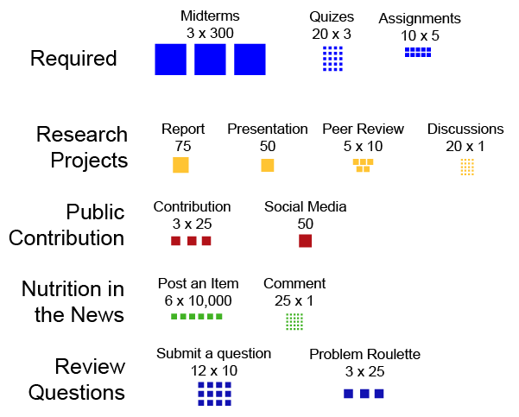
Picking Assignments
Pick and choose based on what is meaningful and effective to your learning
Take risks!
Some individual, some in groups
Notes:
Review Qs submitted on canvas
Describe review session

Slide 17
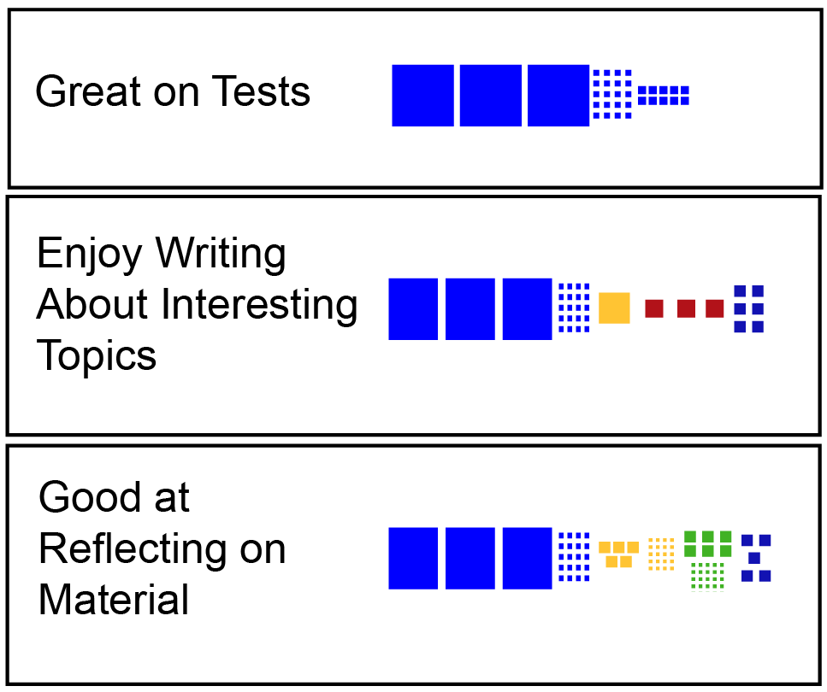
Levels and Grades
1000 points to get an A
Many routes to get to 1000 points
Notes:
Have Rina

Slide 18
Questions about this approach?
Should I do all or most of the optional assignments, just in case?
Should I wait until I see how I am doing on the midterms before picking assignments?
What if I have an idea that isn’t reflected in the assignments, or want to do something slightly different?
This seems like a lot of choices and is overwhelming, how should I start?

Slide 19
GradeCraft Demo, switch computers!

Slide 20
Gameful Learning Advice
Read the summaries of the assignments and think about how you want to do
Use Grade Predictor to plan out how and when to do these assignments
Leave some room to take a risk and if needed try something else

Slide 21
How to Win at NUTR630

Slide 22
Make this class your own
Pick a path that is best for you
Work with study groups
Reach out to the instructional team

Slide 23
Making Use of the Handouts
Read the required readings
Canvas is where readings are posted
Also lists extra information, videos, optional assignments
Give yourself some time to identify what is clear and what is unclear
Ask the instructional team extra materials if you need them
Ask questions in class, or on Piazza
Vocabulary issues
Review the materials after class
Write multiple choice review questions (Optional assignment)

Slide 24
Concept Inventory
Notes:
10- 15 minutes

Slide 25
Course Goals
Develop in-depth understanding of digestive tract anatomy and process of digestion, absorption and transportation mechanisms
Macronutrient metabolism (carbohydrates, proteins, lipids)
Describe structure and properties
Describe digestion, absorption, transportation
Explain human metabolism
Understand inter-organ mechanisms
Notes:
Bulk of course focuses on 3 macronutrients

Slide 26
Essentiality, Energy and Efficiency
Essentiality
What can we make what must we ingest?
Energy from Macronutrients
Efficiency
Is inefficiency good or bad?
Efficiency of digestion
Energy used in storage/release
Futile cycles

Slide 27
Which of these macronutrients can we make ourselves and do not need from the diet?
Alanine
Lysine
Omega 6 Fatty acids
Vitamin D

